Slide 1
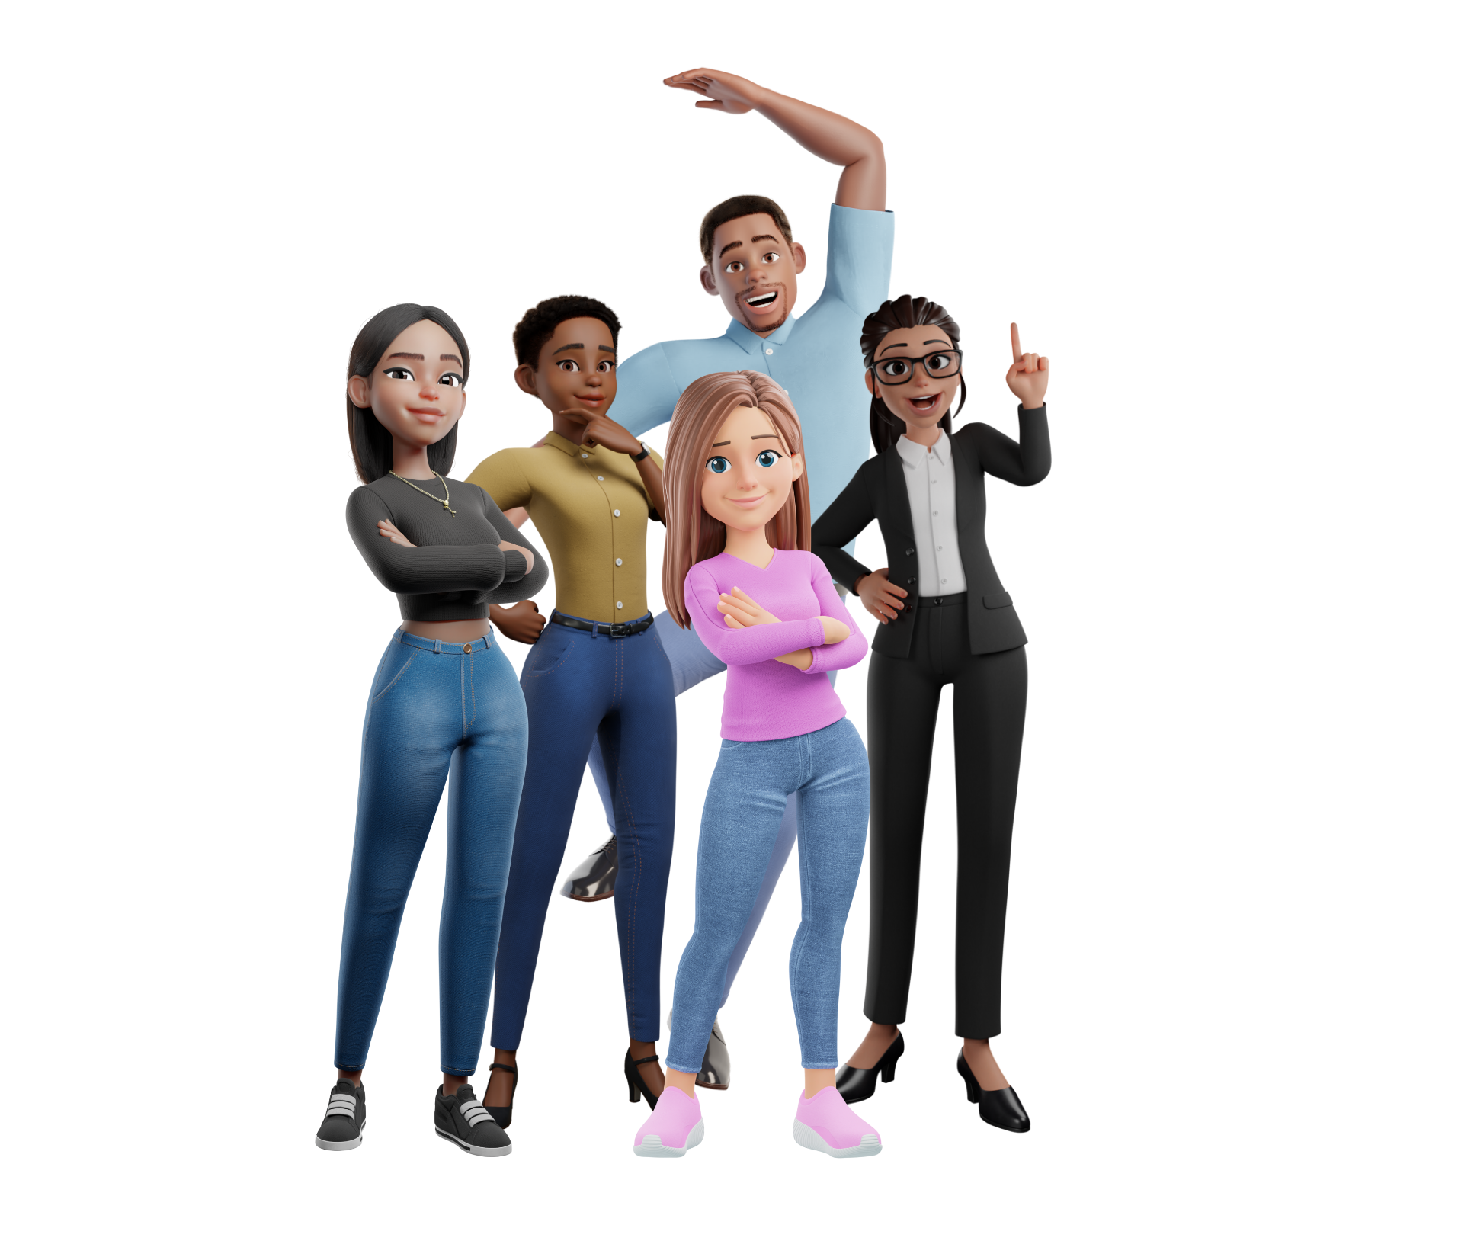
Power Platform What’s new?
Let’s look at some key take-aways from Build this year.
Notes:
https://www.figma.com/@zudrit
https://www.figma.com/@pittmandigital

Slide 2
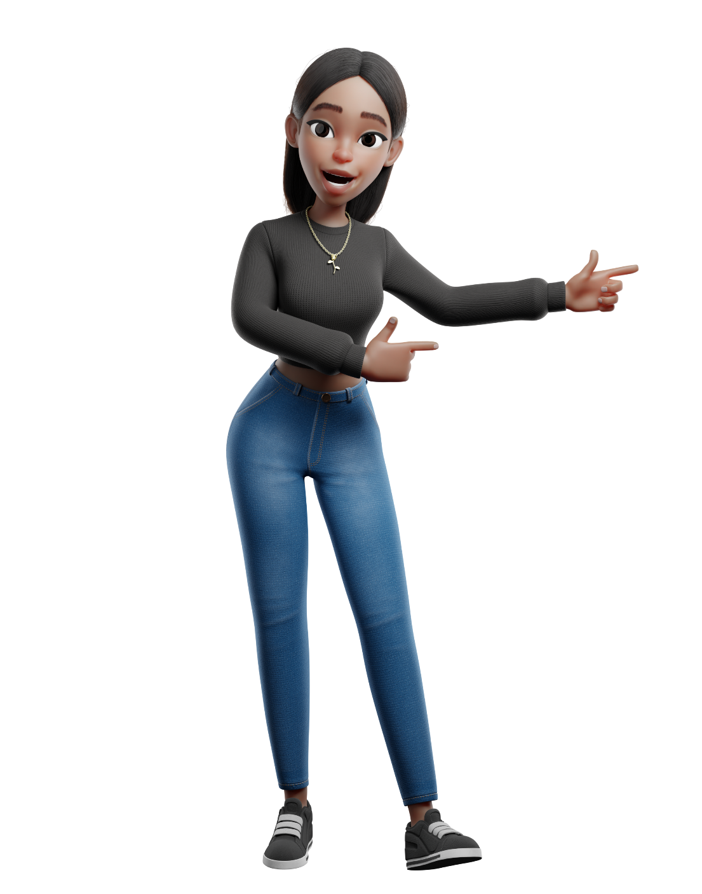
Copilots EVERYWHERE
Let’s play with Copilot in the Power Platform
Notes:
https://www.figma.com/@zudrit

Slide 3

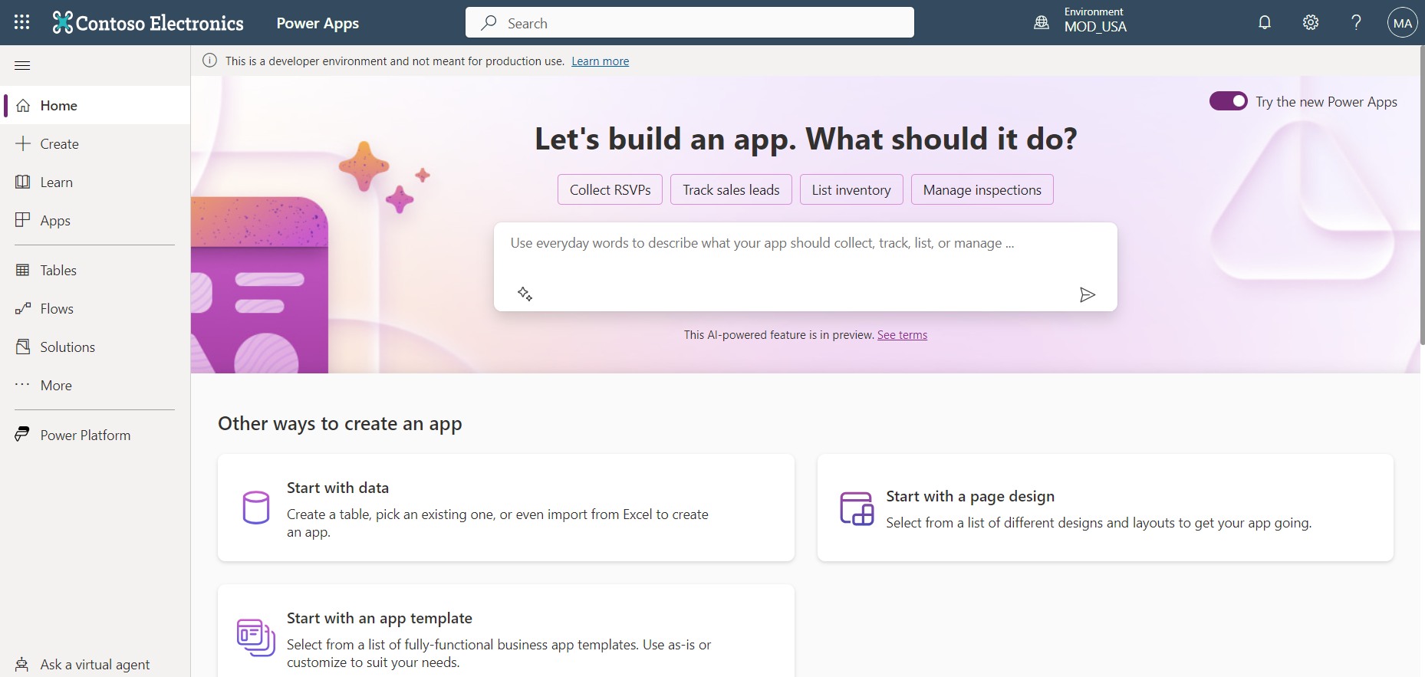
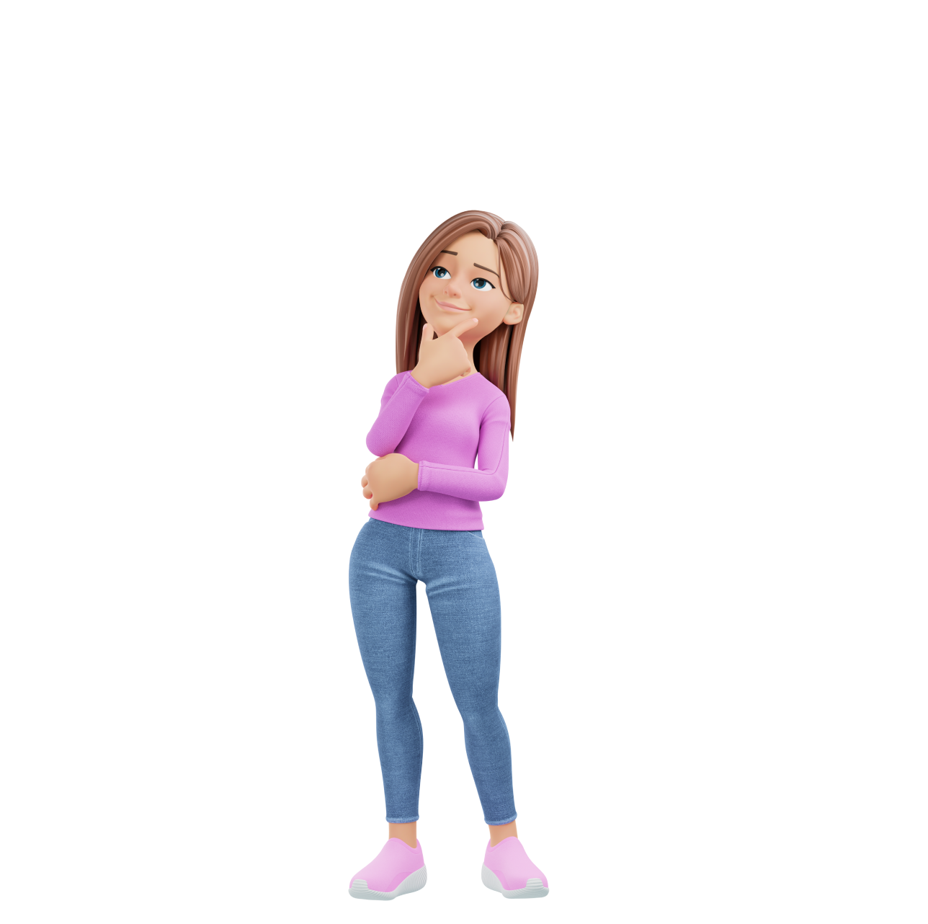
Copilot in Power Apps
Notes:
https://www.figma.com/@zudrit
https://www.figma.com/@pittmandigital

Slide 4
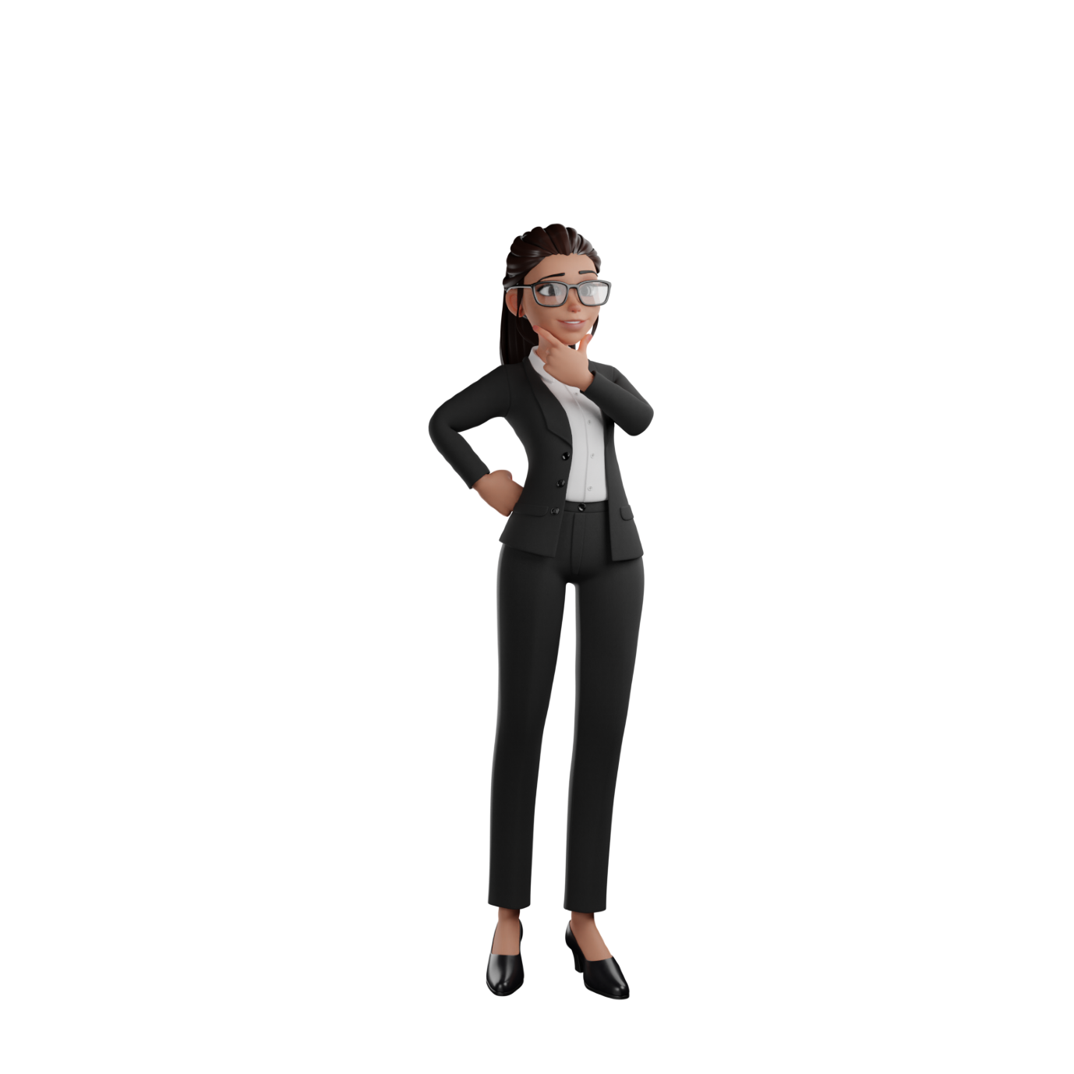

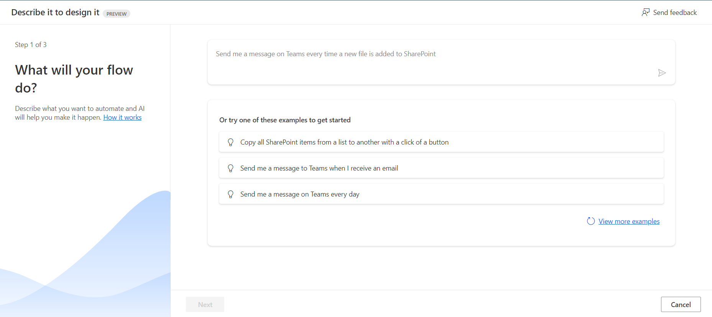
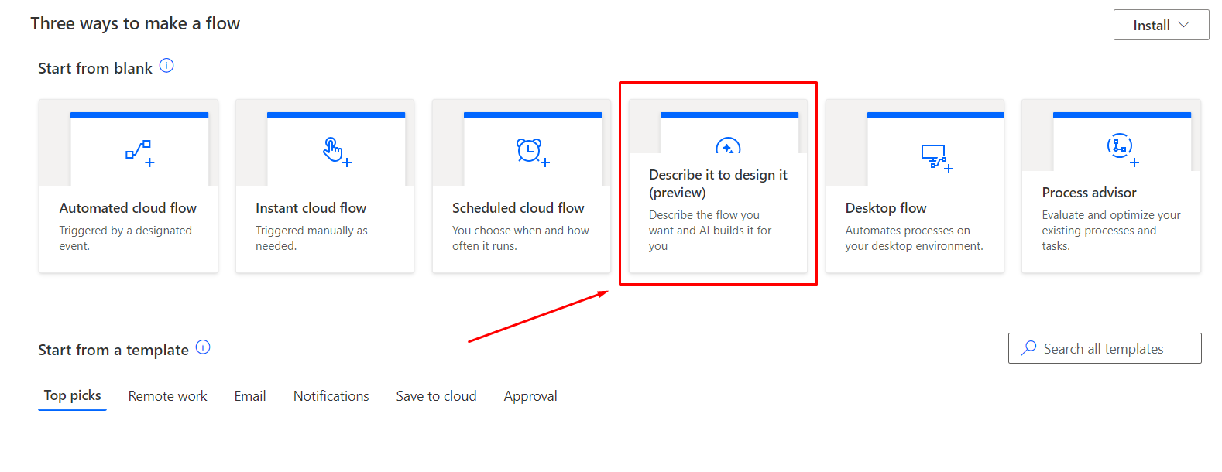
Copilot in Power Automate
Notes:
https://www.figma.com/@zudrit
https://www.figma.com/@pittmandigital

Slide 5

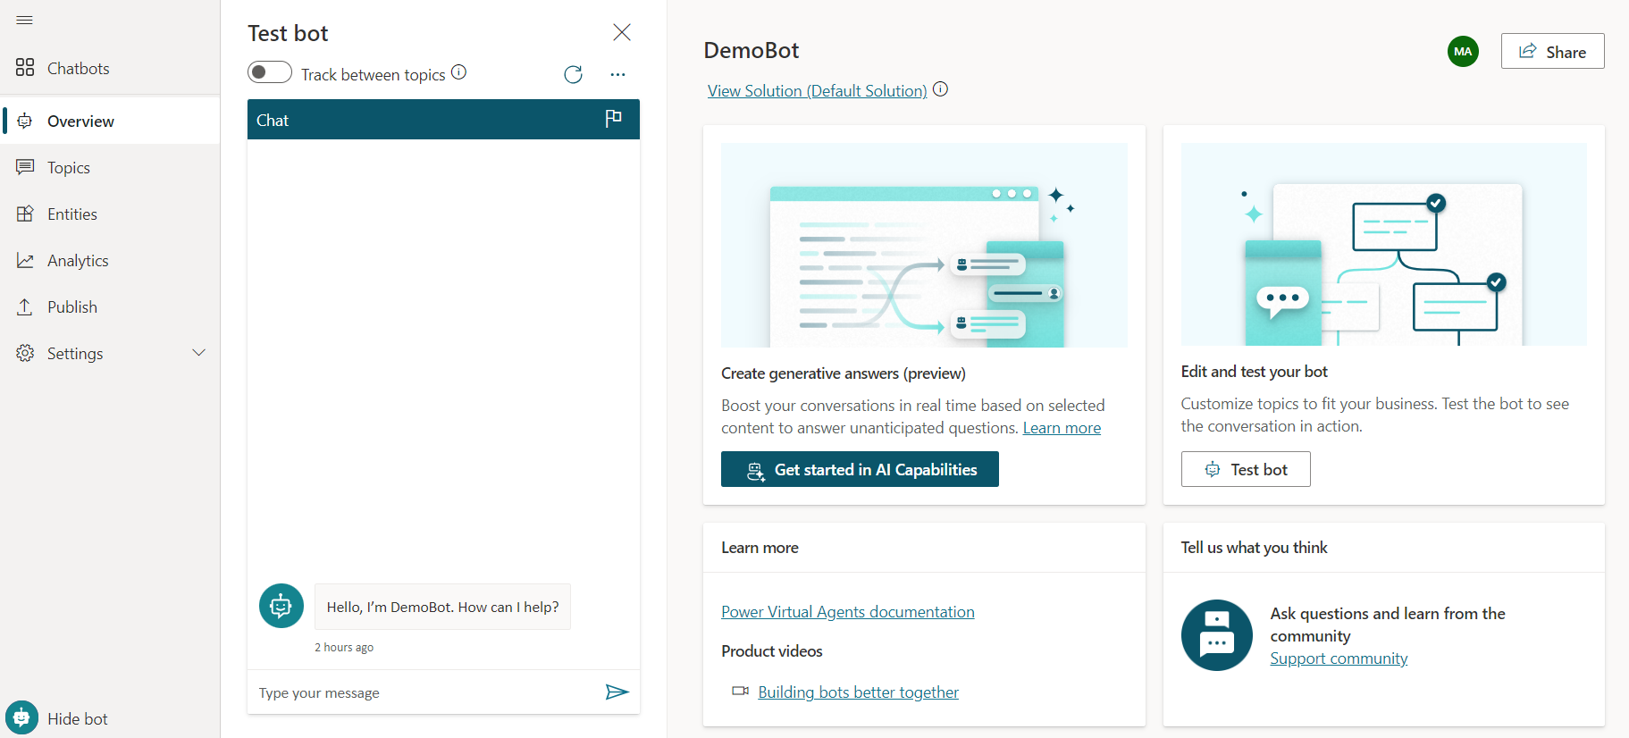

Copilot in Power Virtual Agents
Notes:
https://www.figma.com/@zudrit
https://www.figma.com/@pittmandigital

Slide 6

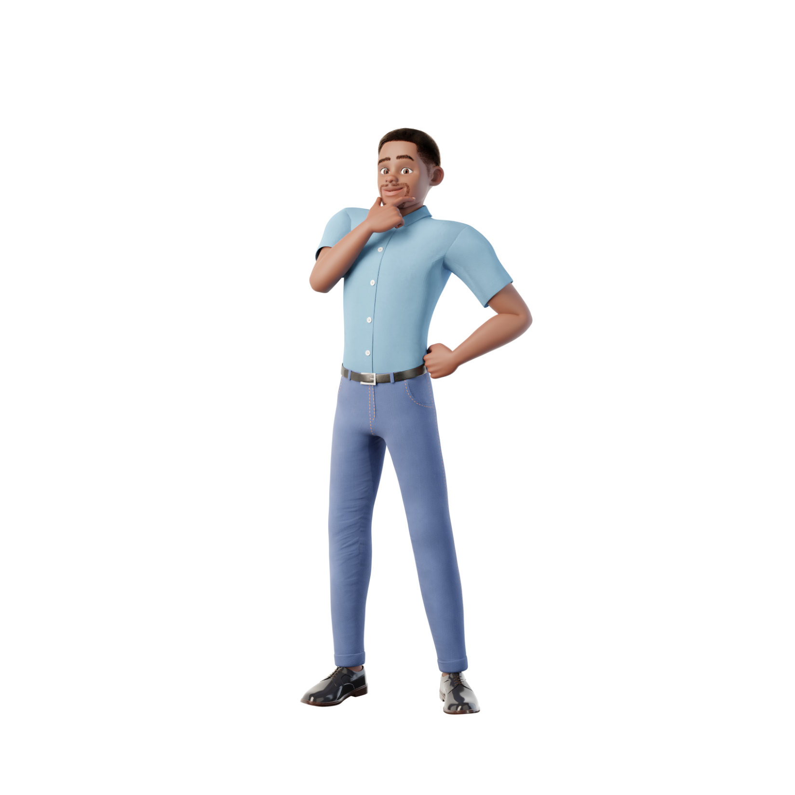

Copilot in Power Pages
Notes:
https://www.figma.com/@zudrit
https://www.figma.com/@pittmandigital

Slide 7
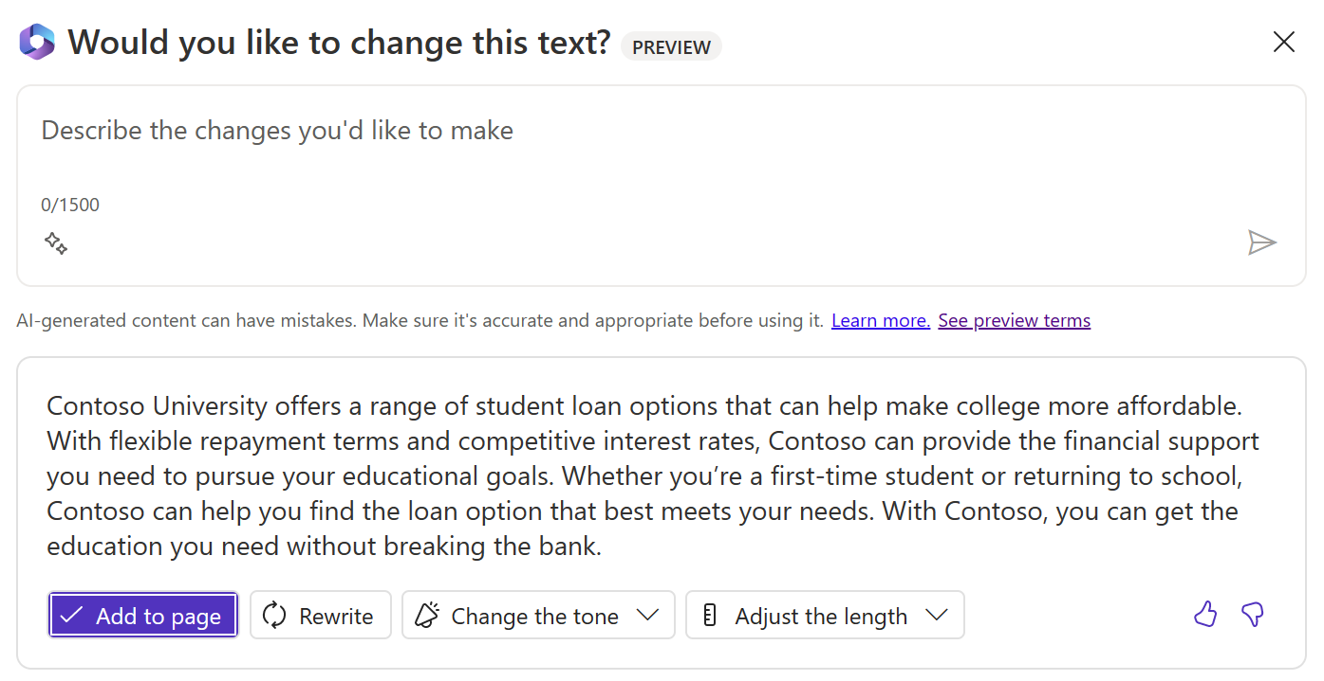
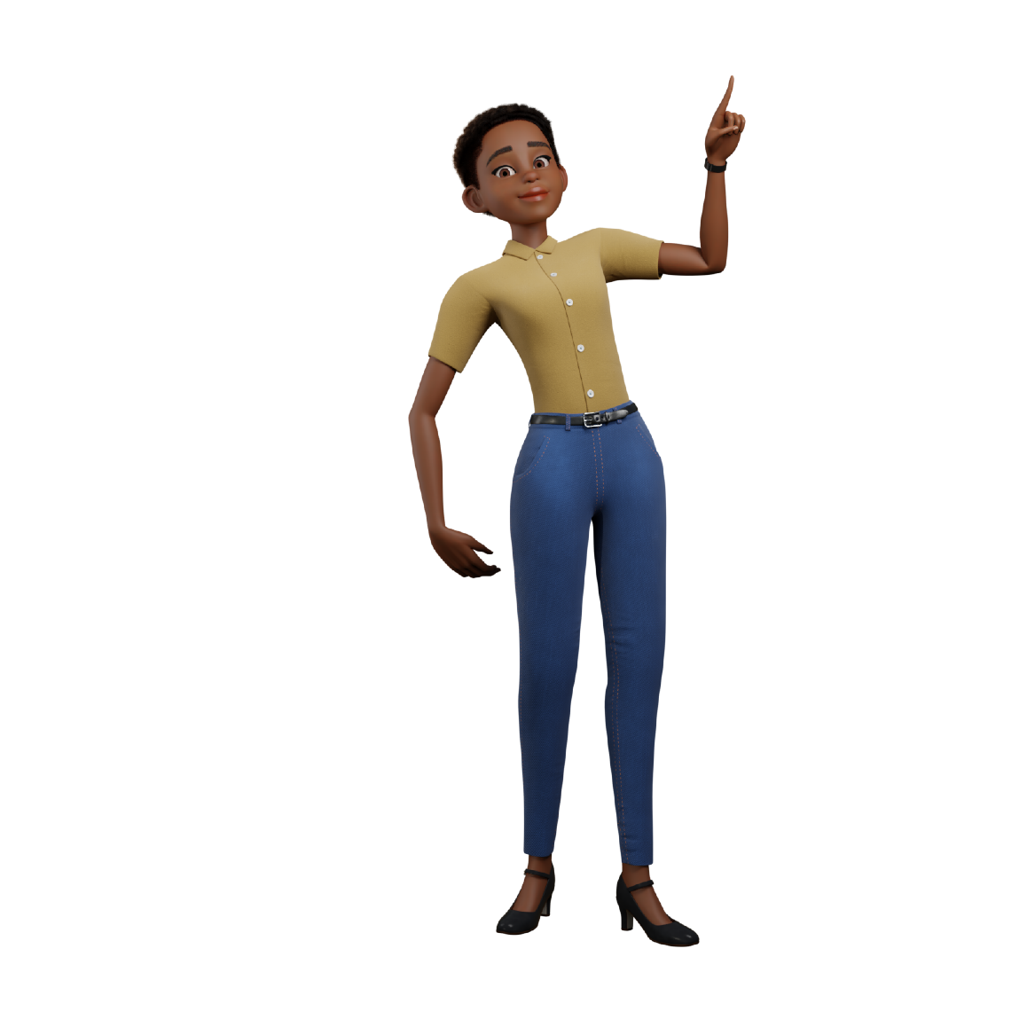
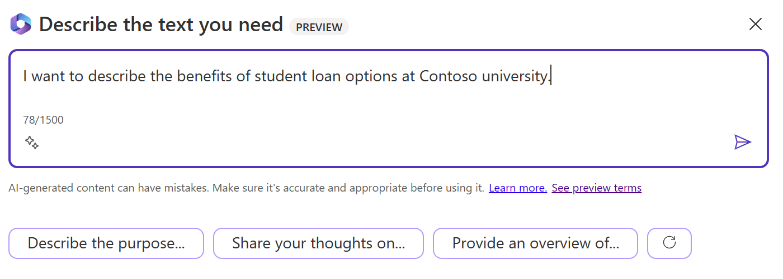
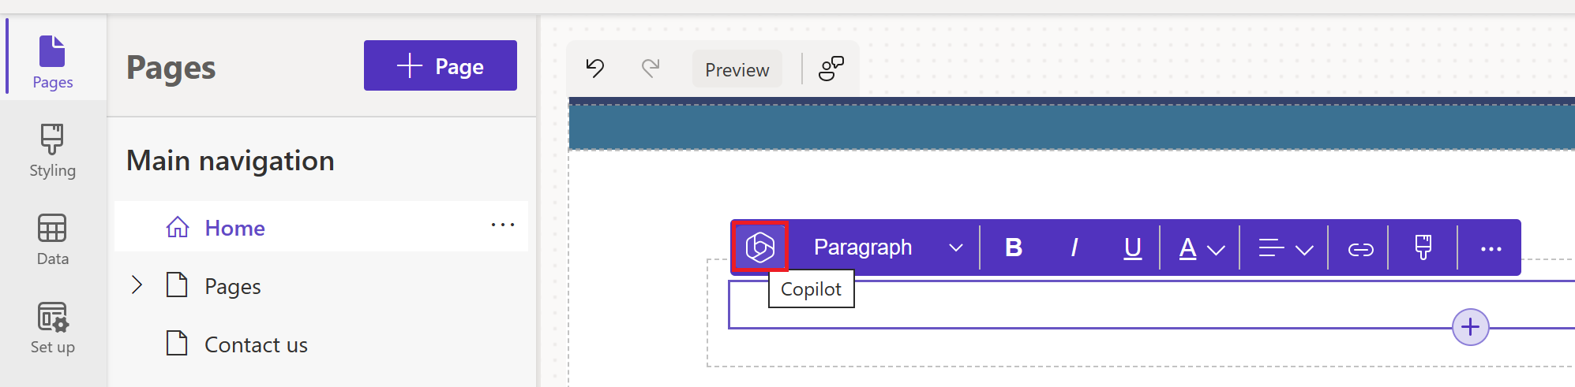
Copilot in Power Pages
Notes:
https://www.figma.com/@zudrit
https://www.figma.com/@pittmandigital

Slide 8
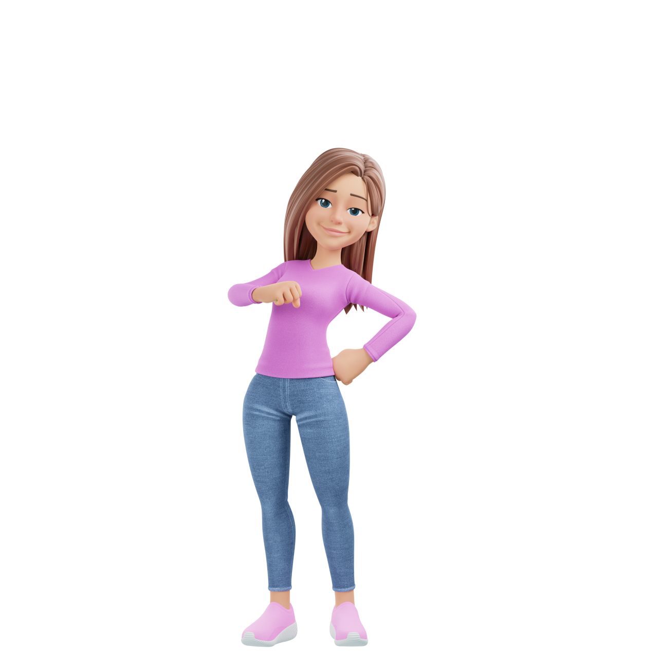
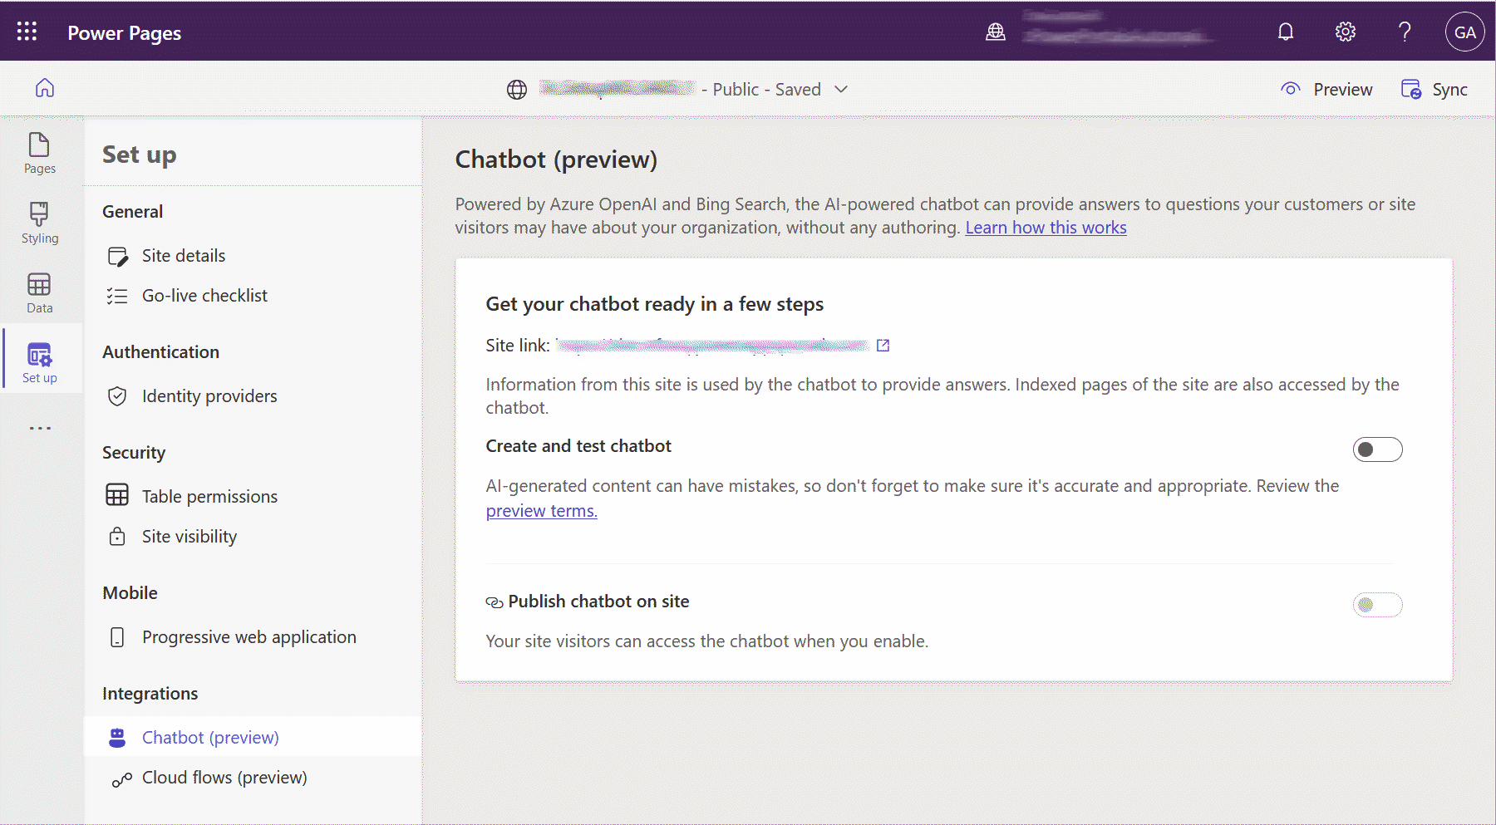
Copilot in Power Pages
Notes:
https://www.figma.com/@zudrit
https://www.figma.com/@pittmandigital

Slide 9


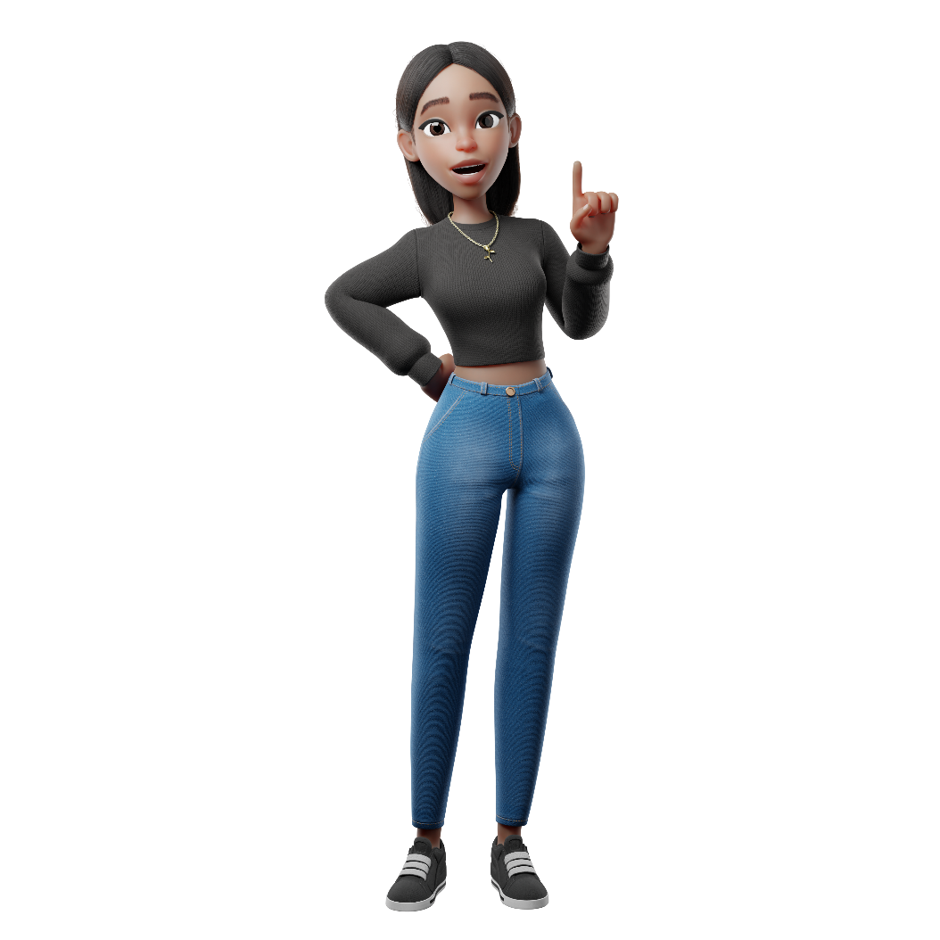
Copilot in Power BI
Notes:
https://www.figma.com/@zudrit
https://www.figma.com/@pittmandigital

Slide 10
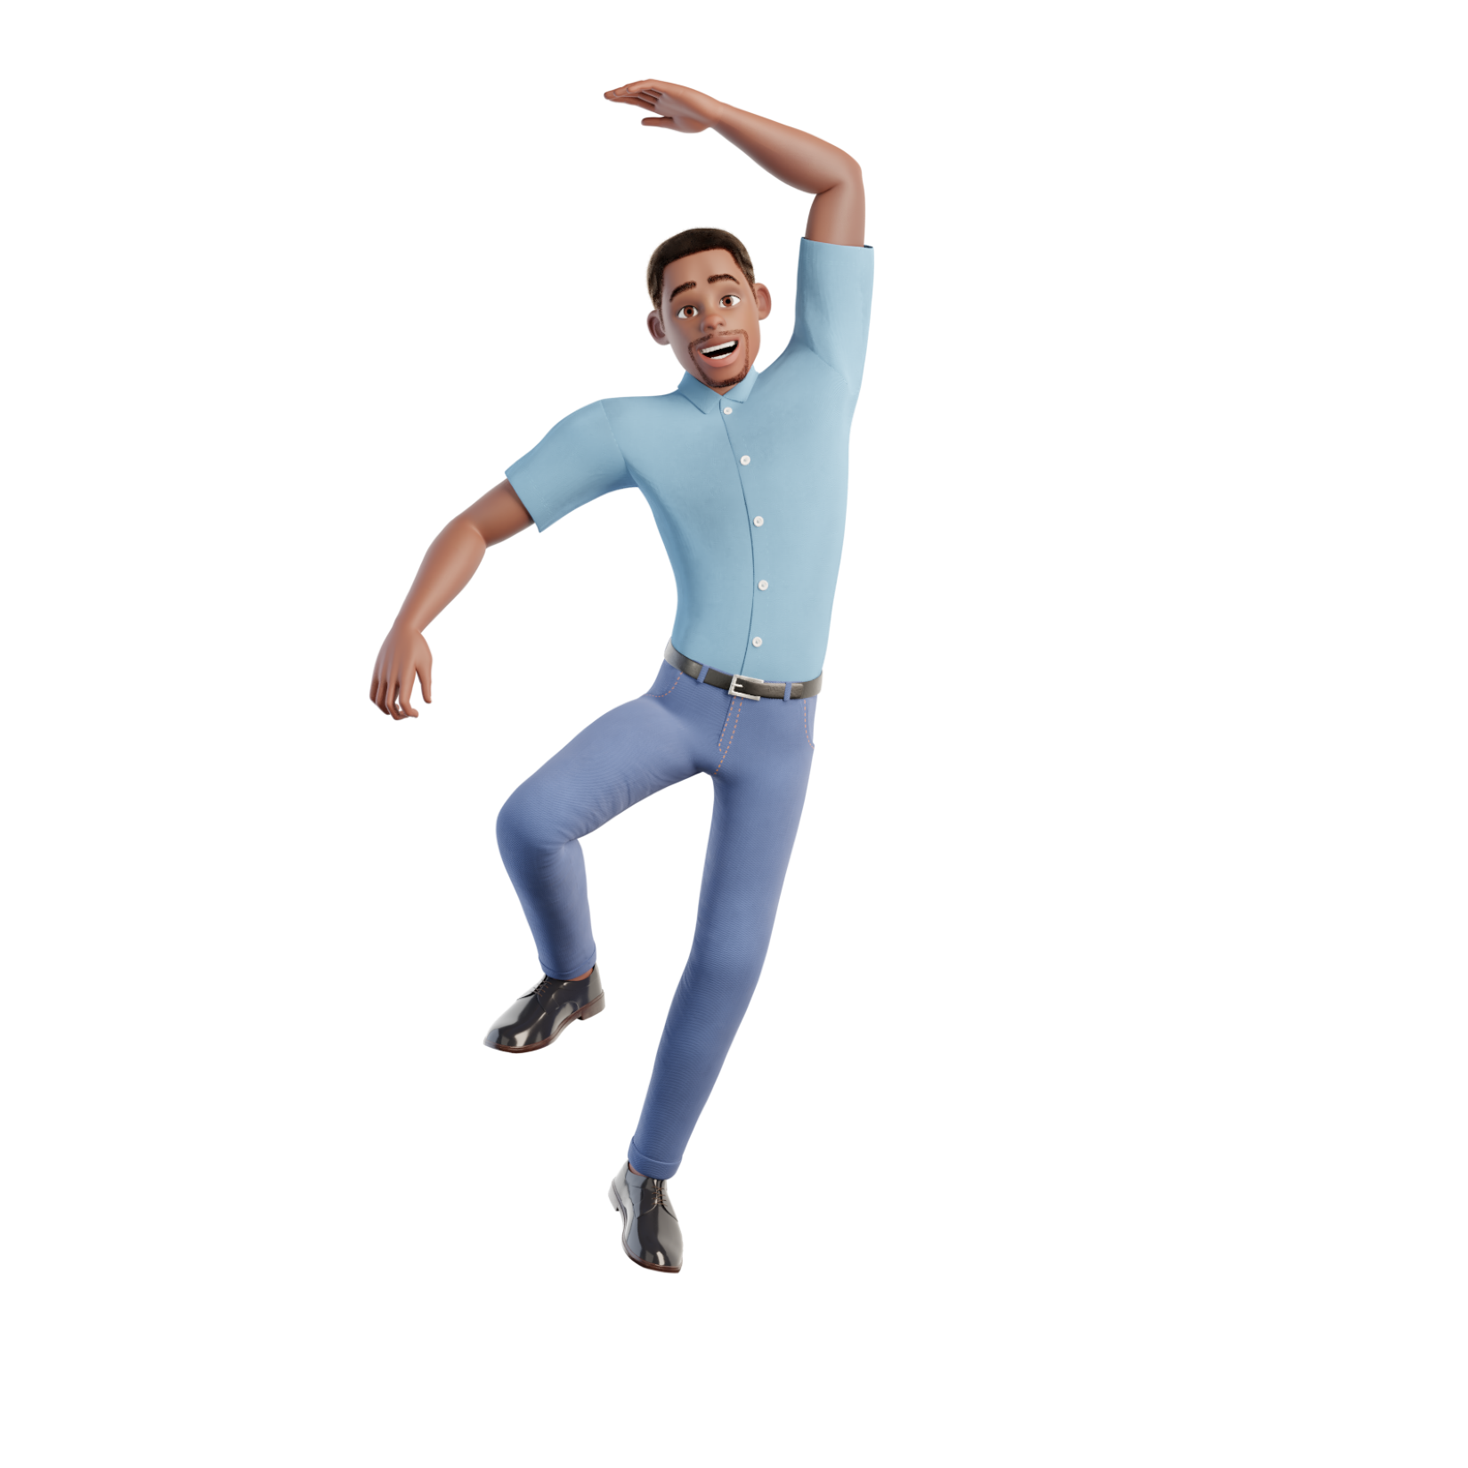
Power Automate Desktop Flow custom actions
Notes:
https://www.figma.com/@zudrit

Slide 11
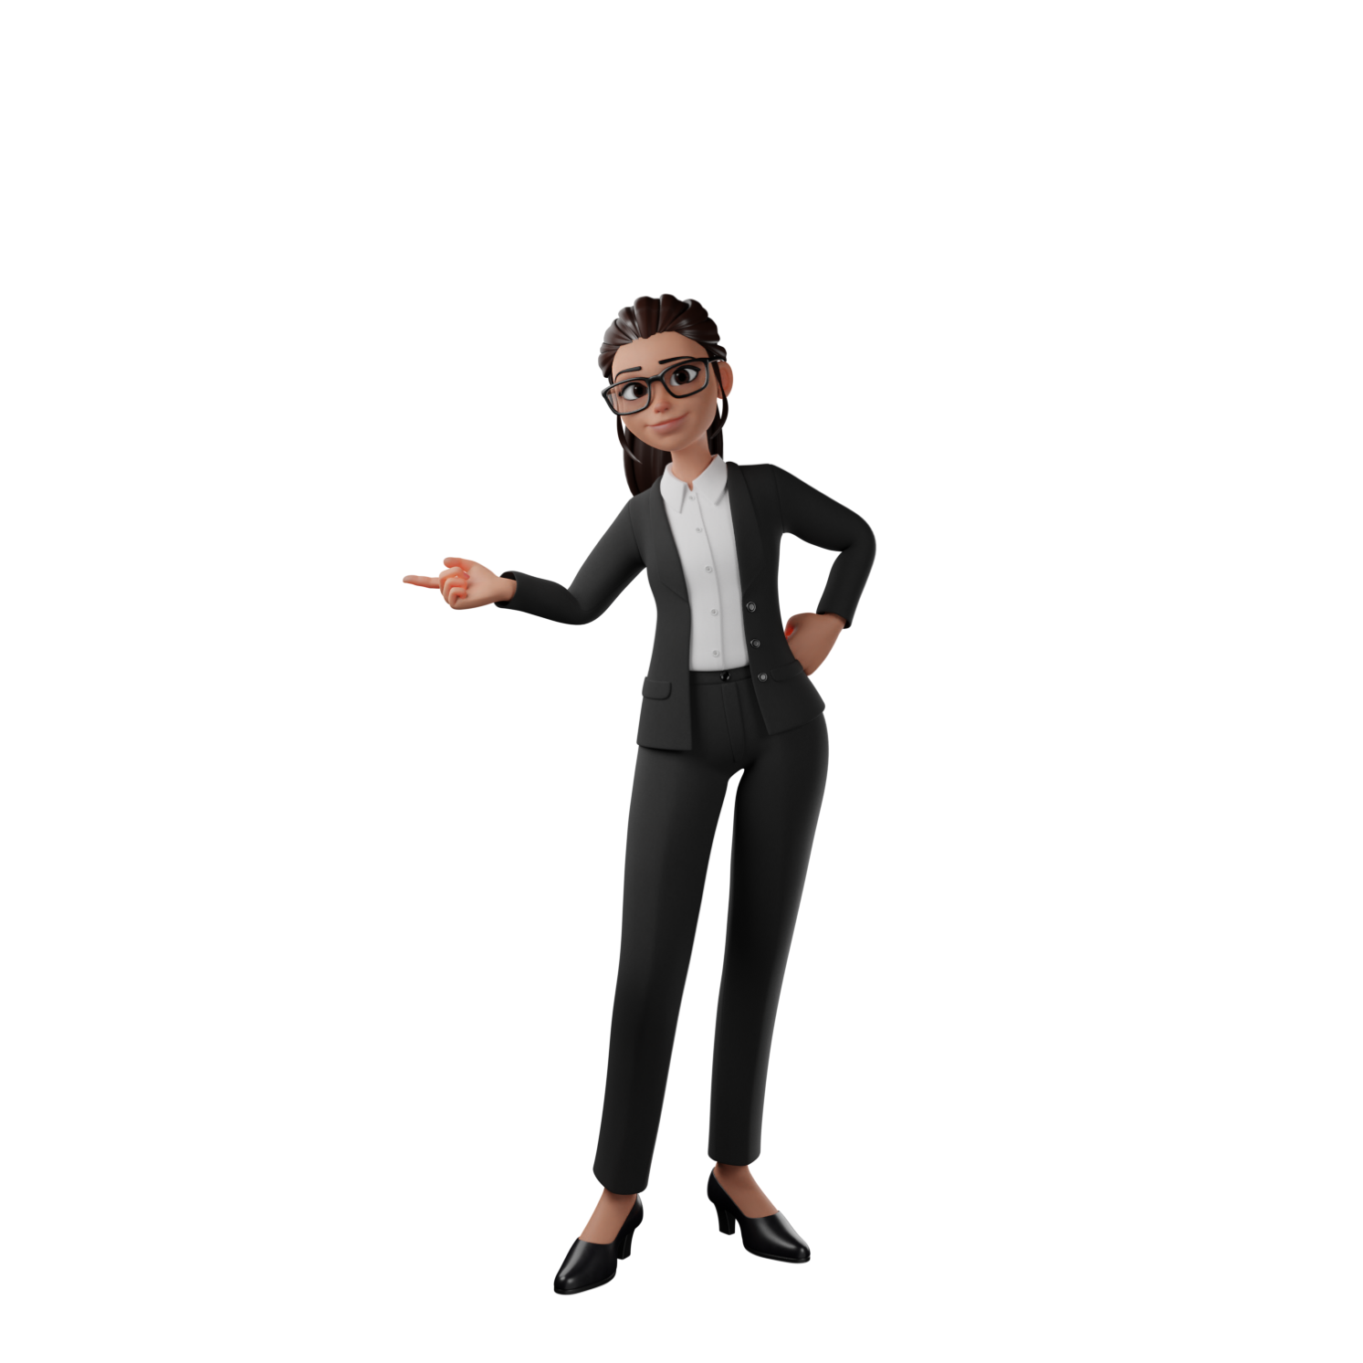
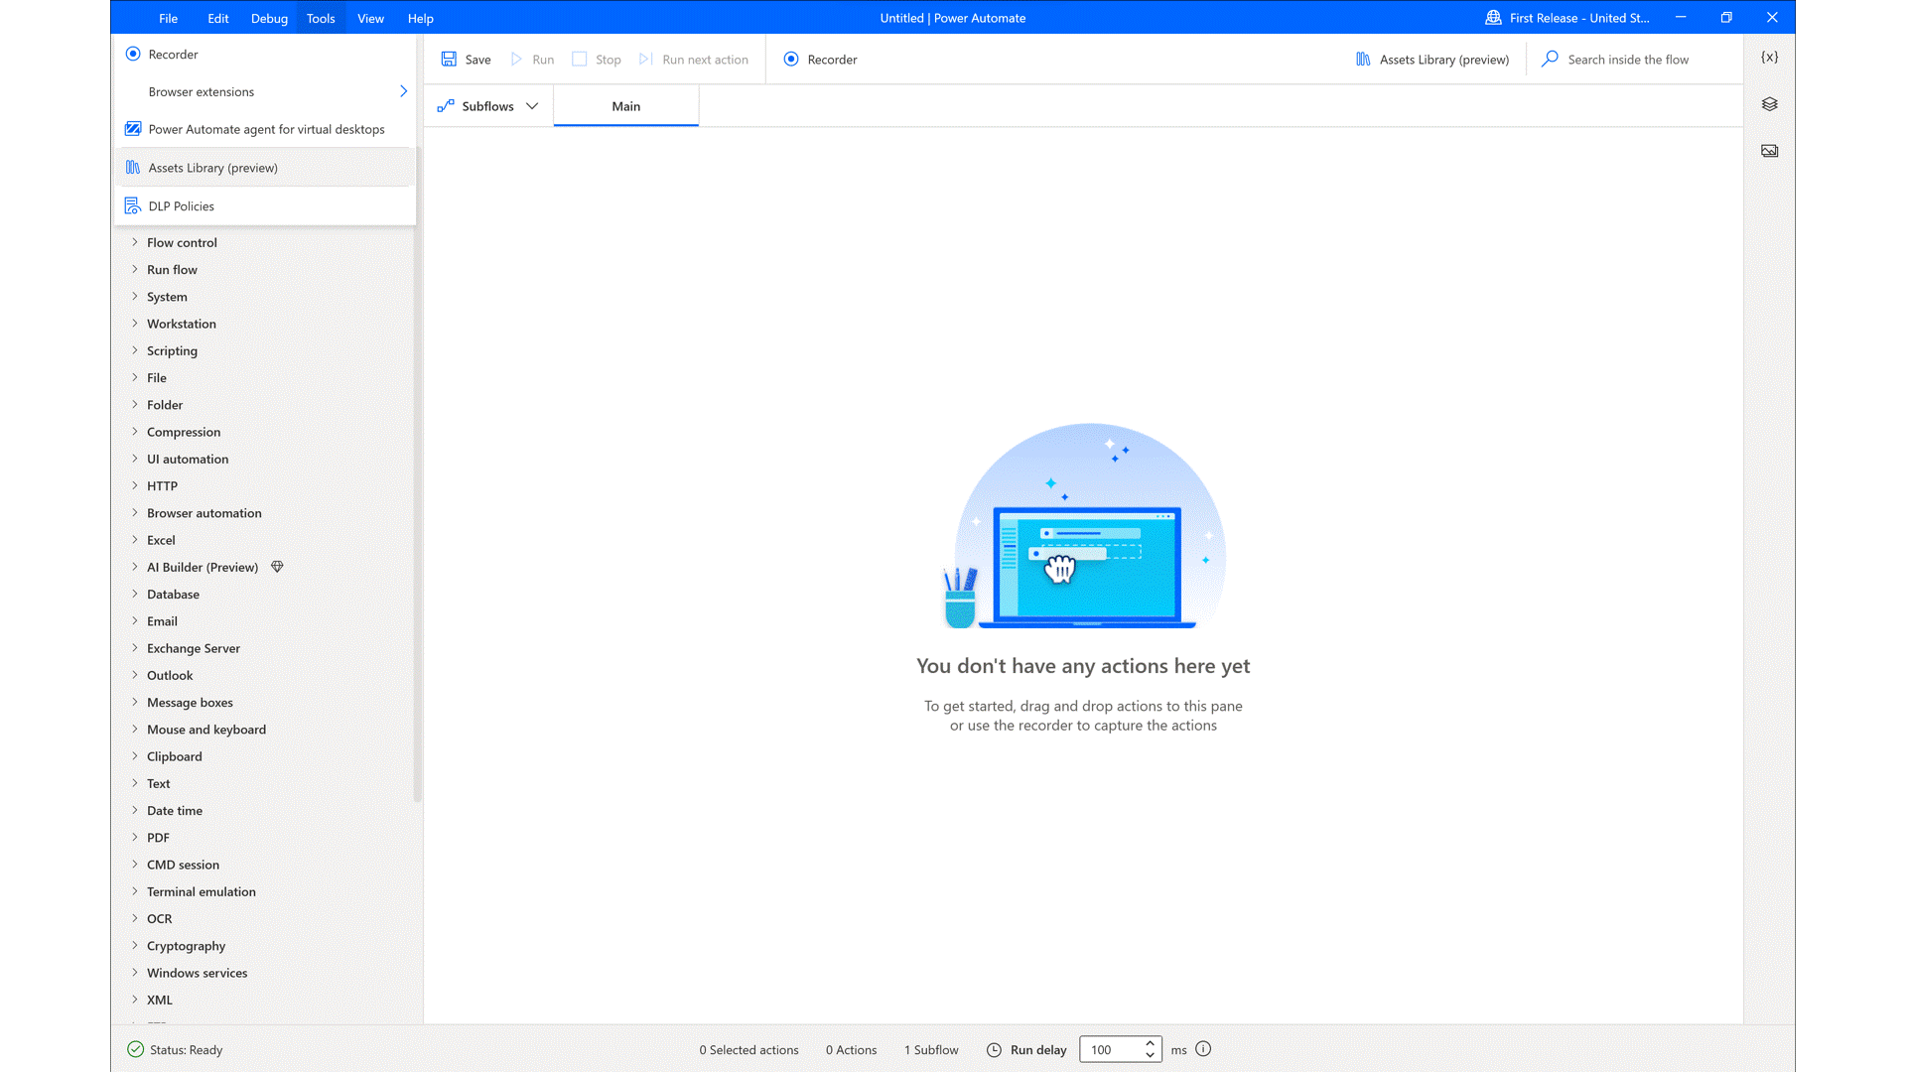
Desktop Flows custom actions
Notes:
https://www.figma.com/@zudrit
https://www.figma.com/@pittmandigital

Slide 12
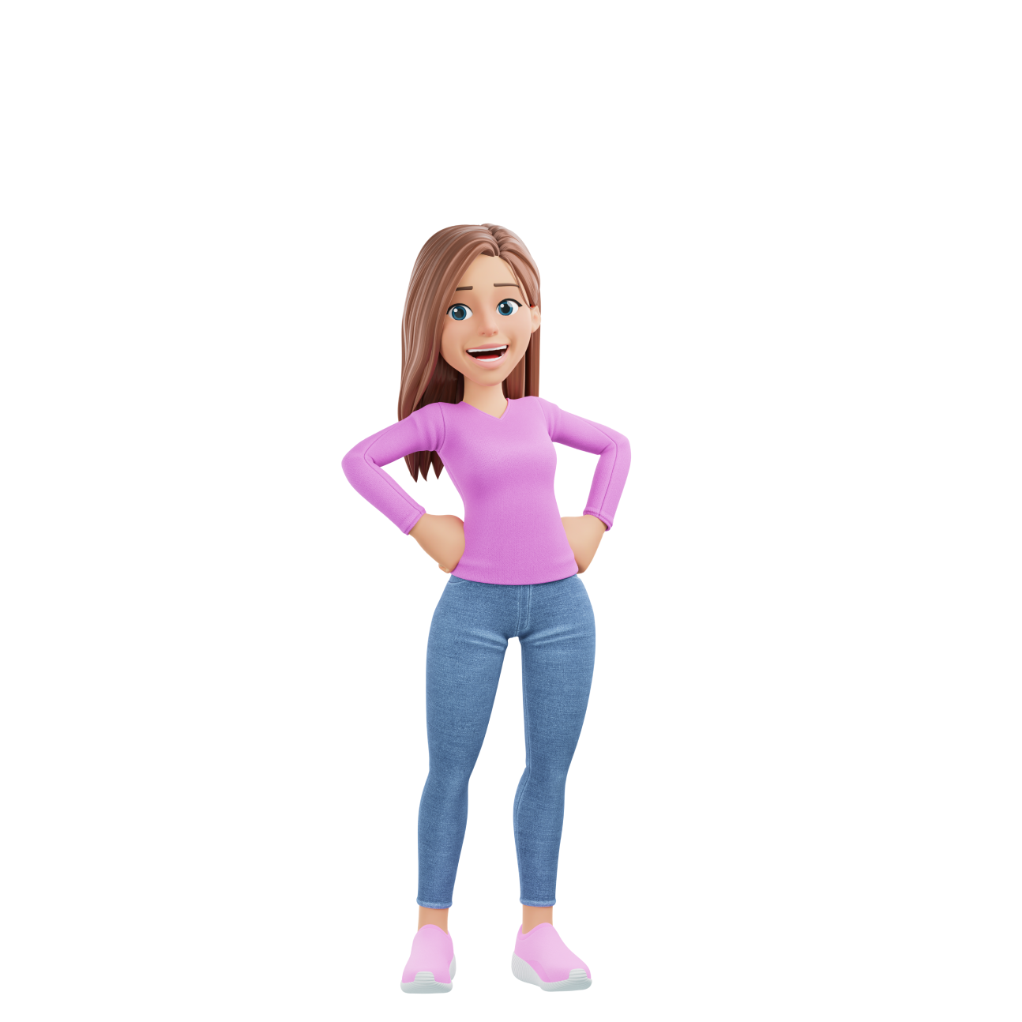
Build a Power App from Excel
No tables required
Formulas are fine
Only pulls from first sheet
And a little more details you should know
Notes:
https://www.figma.com/@zudrit
https://www.youtube.com/watch?v=KD_FnyqH3Lo

Slide 13
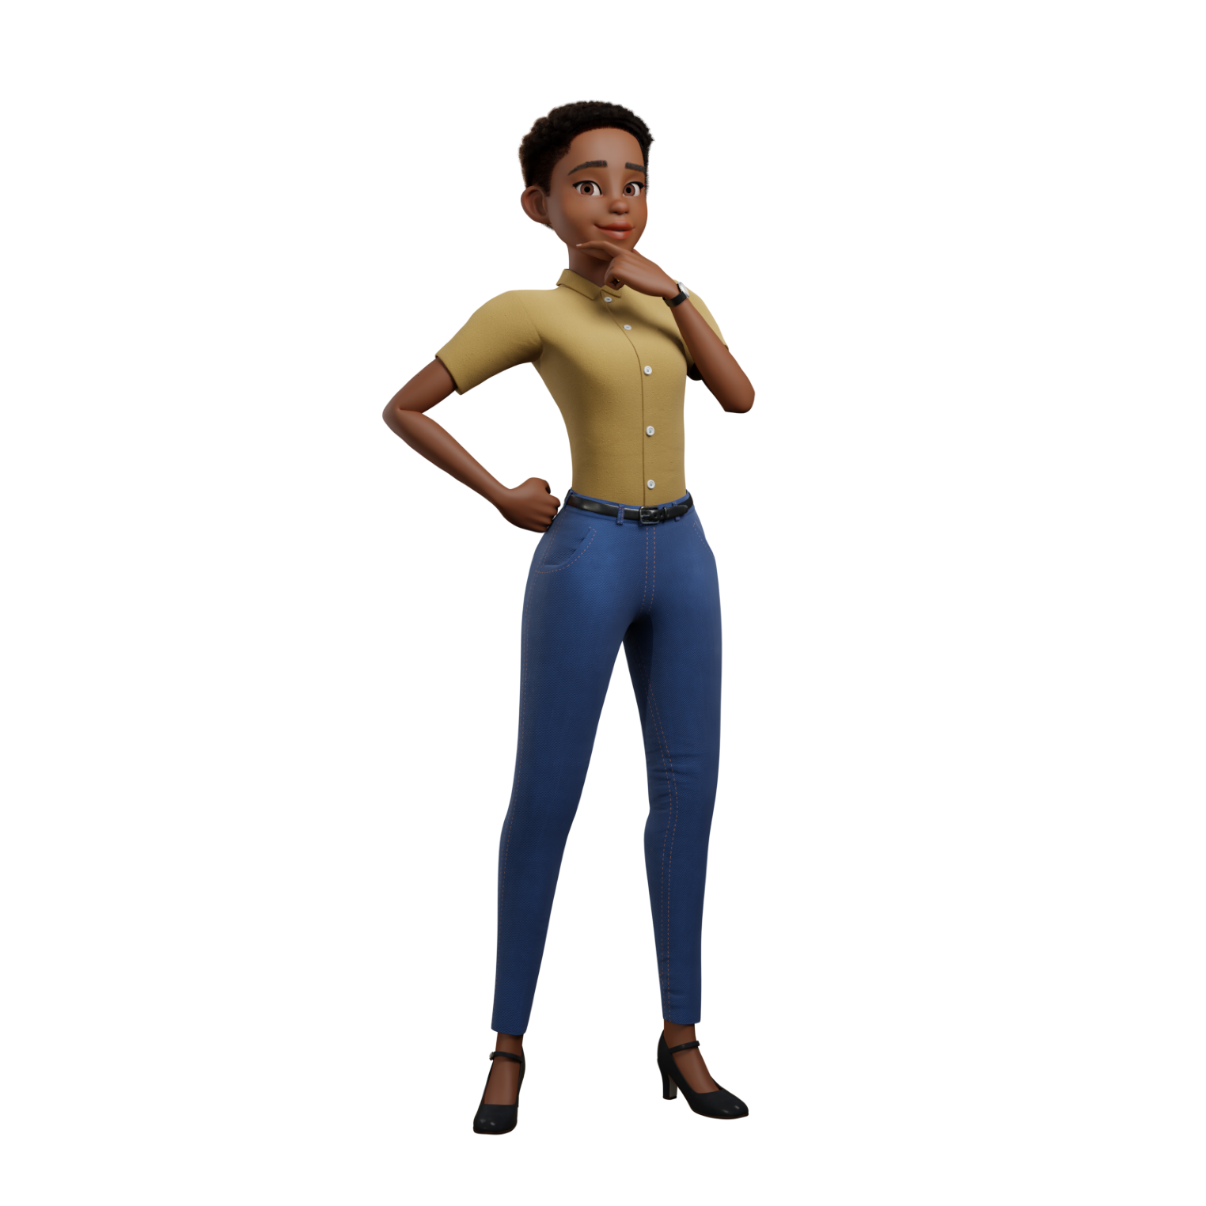
Catalog in Power Apps
With every new app that developers create, their organization will enjoy the benefits of a robust catalog that reduces the time and cost of each new app. Moreover, the catalog enables IT admins to maintain and govern their app ecosystems while supporting the organization’s compliance and security.
Notes:
https://www.figma.com/@zudrit

Slide 14
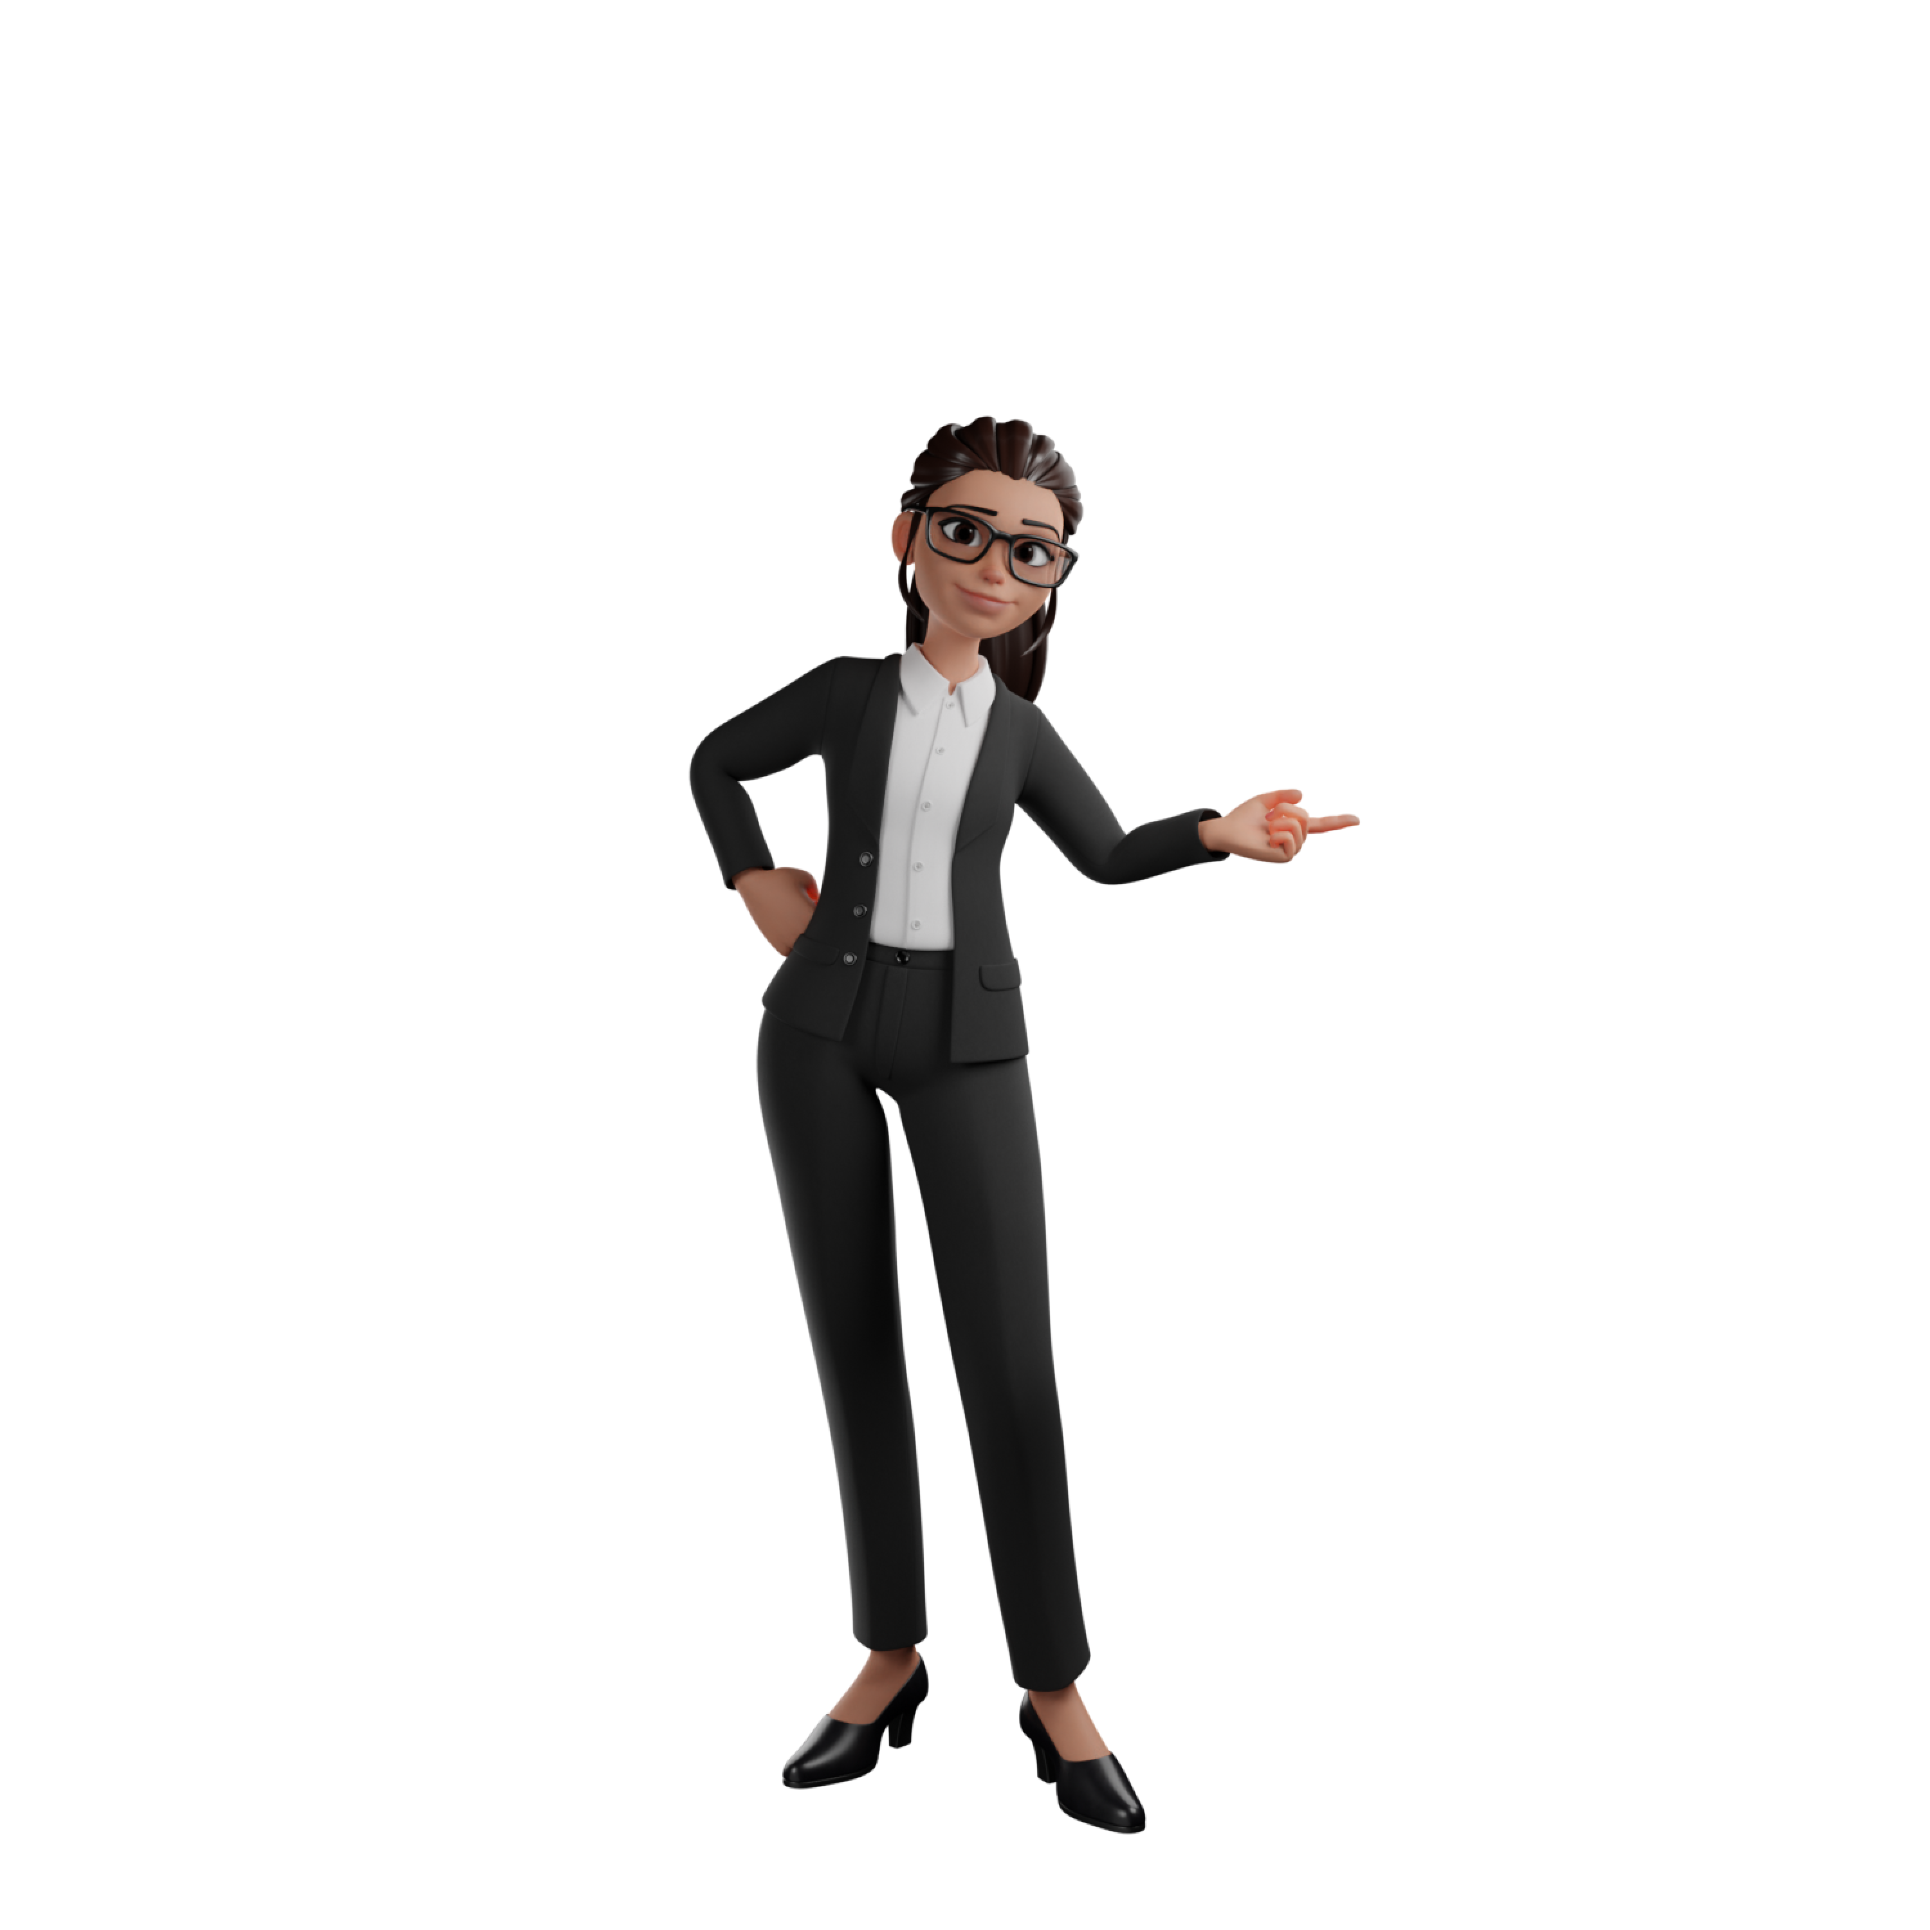
Microsoft Fabric
Reshape how everyone accesses, manages, and acts on data and insights by connecting every data source and analytics service together—on a single, AI-powered platform.
Notes:
https://www.figma.com/@zudrit

Slide 15

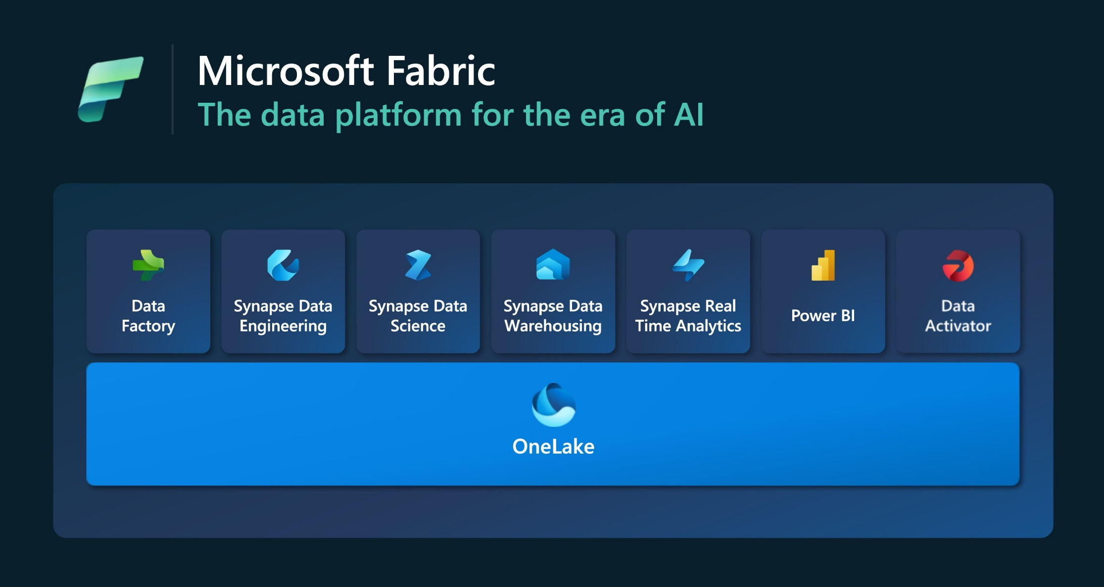
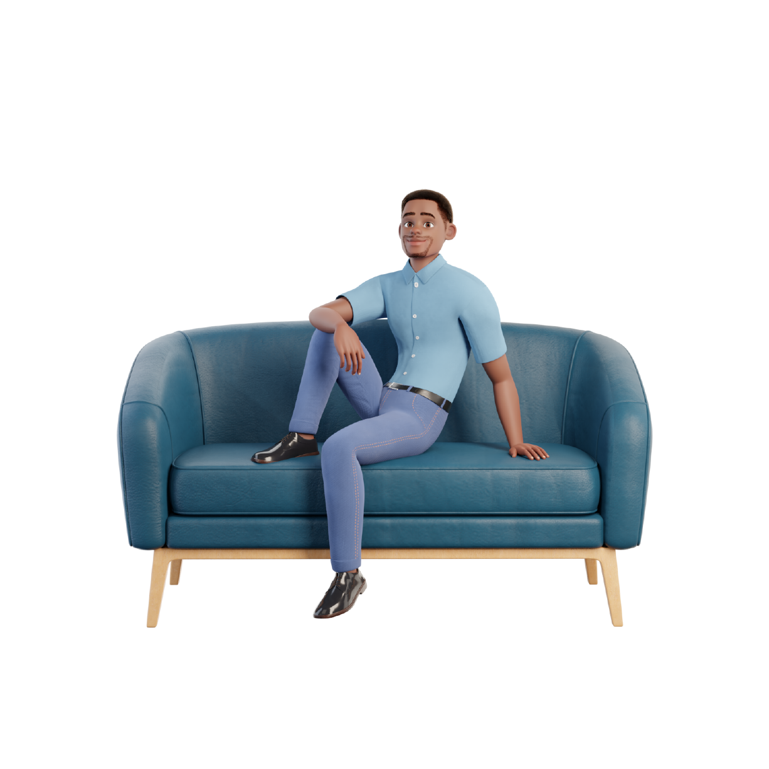
Microsoft Fabric
Notes:
https://www.figma.com/@zudrit
https://www.figma.com/@pittmandigital

Slide 16

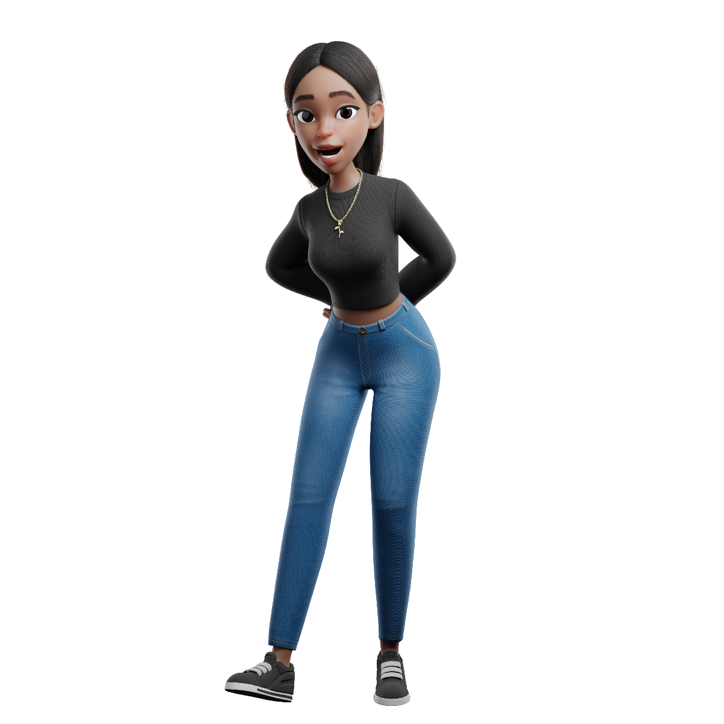
Microsoft Fabric
Notes:
https://www.figma.com/@zudrit
https://www.figma.com/@pittmandigital

Slide 17
Thank YOU!
Notes:
https://www.figma.com/@zudrit
https://www.figma.com/@pittmandigital

